Slide 1

Academic Session 2025-26
Even Semester Jan-May 2026
UNIVERSITY INSTITUTE OF ENGINEERING
AIT-CSE (AIML)
CS221: B.E. CSE (AIML)
6th Semester
Artificial Intelligence
(23CSH-378)
Unit No. 1 Chapter No. 1.3 Lecture No. 11 to 15
Topic : Game Playing and Adversarial Search
Dr. Prabhjot Kaur (E16646) Assistant Professor

Slide 2
COURSE OBJECTIVES
1
The course aims to:
To develop an architecture and components of expert systems and distinguish them from conventional programming approaches.
To apply knowledge representation and knowledge acquisition techniques for designing intelligent and rule-based systems.
To explain inference mechanisms and explanation systems used in expert systems for effective decision making.
To understand AI planning approaches, including classical, hierarchical, and multi-agent planning for real-world problem solving.
To explore AI applications in robotics and computer vision, including path planning, obstacle avoidance, object detection, and SLAM using OpenCV.

Slide 3

COURSE OUTCOMES
2
On completion of this course, the students shall be able to:
CO1 | Recall the fundamental concepts of AI, including intelligent agents, problem-solving approaches, and search strategies.
CO2 | Illustrate the various search techniques, including uninformed and heuristic-based methods, to solve AI-related problems.
CO3 | Implement rule-based systems using forward and backward chaining for decision-making and learning.
CO4 | Analyze and evaluate different knowledge representation techniques, logic programming, and reasoning methods in AI.
CO5 | Design and implement uncertainty handling techniques, including probabilistic reasoning, fuzzy logic, and Bayesian networks.

Slide 4
Unit-I Syllabus
3
Unit-1 | Regression | Contact Hours: 15
Introduction to AI | Introduction, AI problems, foundation of AI and history of AI intelligent agents: Agents and Environments, the concept of rationality, the nature of environments, structure of agents, problem solving agents, problem formulation.
Search Strategies in AI | State Space Representation, uniformed search strategies – Breadth first search, depth first Search. Informed Search Strategies (Heuristic search) Hill climbing, A*, AO* Algorithms, Problem reduction, Constraint Satisfaction Problems (CSP)
Game Playing and Adversarial Search | Introduction, Adversarial Search Algorithms: Mini-Max Algorithm, Optimal Strategies for Game Playing, Alpha-Beta Pruning (Optimization of Mini-Max),Move Ordering and Efficiency Improvements, Game Trees and State Representation, Real-World Applications of Game AI
Self-Study | Backtracking, local search, and arc consistency techniques, Designing heuristics for strategic decision-making, Probabilistic decision-making in game AI

Slide 5
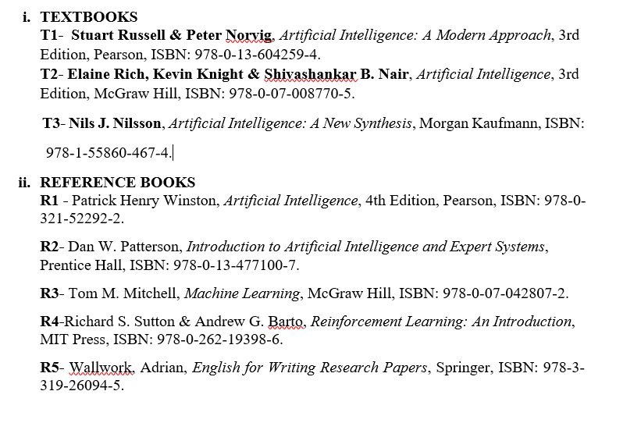
SUGGESTIVE READINGS
4

Slide 6
Table of Contents
5
Adversarial Search Algorithms
Optimal Strategies for Game Playing
Alpha-Beta Pruning (Optimization of Mini-Max)
Move Ordering and Efficiency Improvements
Game Trees and State Representation
Real-World Applications of Game AI

Slide 7

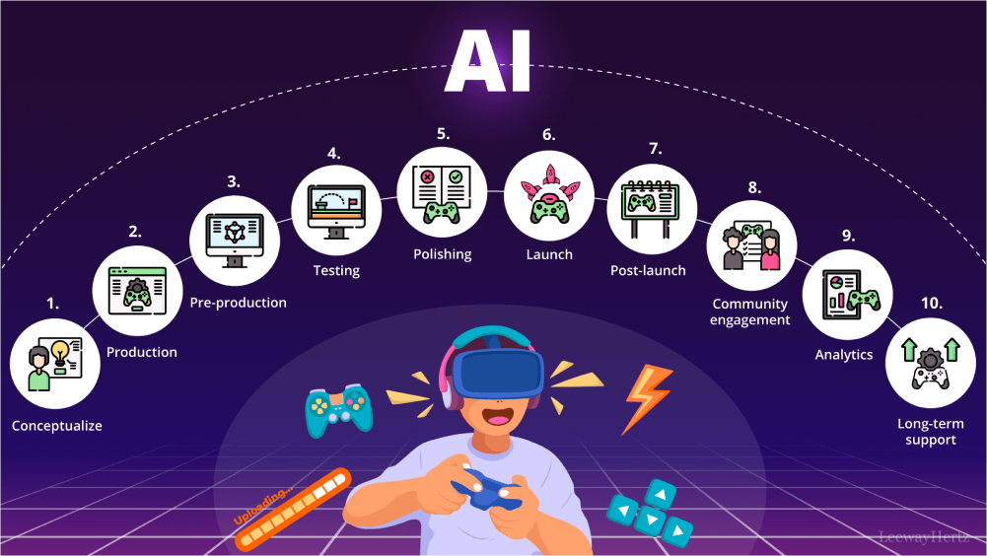
Game Playing in AI:
AI technique to make decisions in competitive environments
Player’s goal is to maximize gain and minimize opponent’s chances.
Game playing has emerged as a cornerstone in artificial intelligence (AI), highlighting its ability to solve complex, strategic problems.
Used in:
•Chess, Ludo, Poker
•Online strategy games
•Real-time simulations

Slide 8
Game (Cont.…)
Game playing has emerged as a cornerstone in artificial intelligence (AI), highlighting its ability to solve complex, strategic problems.
With AI's ability to learn, adapt, and make strategic decisions, it is now becoming an essential player in various gaming domains, reshaping how we experience and interact with experience and interact with games.
Game playing in artificial intelligence refers to the development of algorithms and models that enable machines to play and excel in games that require decision-making, strategy, and problem-solving.
Games don't require much knowledge; the only knowledge we need to provide is the rules, legal moves and the conditions of winning or losing the game.

Slide 9
Key Characteristics:
Multi-agent environment: More than one player/agent interacts and makes decisions within the same system.
Conflicting objectives: Each player tries to win, so one player’s gain is another player’s loss.
Turn-based decision making : Players take actions one after another rather than at the same time.
Uncertain outcomes : Final results depend on both opponent moves and chance, making predictions difficult.

Slide 10
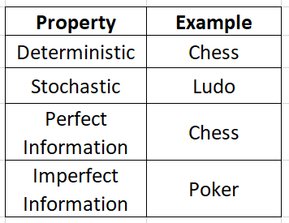
Adversarial Search:
Adversarial search deals with decision-making when two or more agents have opposite goals.
Type of Games:

Slide 11
Game Playing in Artificial Intelligence
Game playing in artificial intelligence refers to the development of algorithms and models that enable machines to play and excel in games that require decision-making, strategy, and problem-solving. These games serve as an excellent medium for testing AI capabilities since they involve well-defined rules, structured environments, and measurable outcomes.
Game playing is significant because it mirrors real-world decision-making processes, where outcomes depend on evaluating multiple possibilities, analyzing opponents, and managing limited resources. By solving these challenges, AI systems enhance their ability to process information efficiently, optimize strategies, and adapt to changing environments, making game playing a fundamental area in AI research and development.

Slide 12
Type of games
AI in game playing can be applied to various types of games, including:
Single-player games: Games like puzzles or solitaire, where the AI competes against itself or static challenges.
Multi-player games: Competitive games such as Chess or Go, where AI plays against a human or another AI.
Deterministic games: Games with no randomness, where outcomes are determined by the player’s decisions (e.g., Chess).
Stochastic games: Games involving randomness or uncertainty, like card games and dice games (e.g., Poker).

Slide 13
Type of games
Game playing in AI can be categorized based on the nature of the game’s structure and information availability. The key types include:
Deterministic vs. Stochastic Games:
  Deterministic games have no randomness; outcomes depend entirely on the players’ moves. Examples include Chess and Tic-Tac-Toe.
  Stochastic games involve randomness or probabilistic events, such as dice rolls or shuffled cards. Examples include Poker and Backgammon.
Perfect vs. Imperfect Information Games:
  Perfect information games allow all players to access complete information about the game state at any point, such as Chess and Go.
  Imperfect information games limit access to certain information, such as the opponent’s hand in card games like Poker.
Zero-Sum Games:
These games involve direct competition, where one player’s gain is another player’s loss. Examples include strategy games like Chess and competitive multiplayer games.

Slide 14
The Role of Search Algorithms in Game Playing
Search algorithms play a fundamental role in AI game playing by enabling systematic exploration of possible moves and outcomes. These algorithms allow AI systems to evaluate game states, predict opponents’ moves, and determine the optimal strategy for success.
Minimax Algorithm:
Minimax is widely used in two-player, zero-sum games like Chess. It evaluates all possible moves for both players by assuming the opponent will play optimally, minimizing the player’s loss while maximizing gains.
Alpha-Beta Pruning:
An optimization of Minimax, Alpha-Beta Pruning reduces the number of nodes evaluated, improving efficiency. It eliminates branches in the search tree that do not affect the final decision, making it ideal for games with deep decision trees.
Monte Carlo Tree Search (MCTS):
MCTS combines random simulations with statistical analysis to determine the best moves. It is particularly useful in games like Go and complex video games, where the state space is vast, and exhaustive search is impractical.

Slide 15
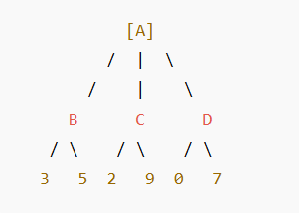
Min-Max Search Algorithm
The Min-Max algorithm is a backtracking algorithm used in decision making and game theory.
It helps the AI choose the best possible move by assuming that the opponent also plays optimally.
MAX player → tries to maximize the score (AI’s turn).
MIN player → tries to minimize the score (opponent’s turn).
Example:
A = root node (AI’s turn → MAX)
B, C, D = opponent’s moves (MIN nodes)
Leaf nodes = scores (game outcomes)
Notes:
Artificial Intelligence is composed of two words Artificial and Intelligence, where Artificial defines "man-made," and intelligence defines "thinking power", hence AI means "a man-made thinking power.“
Artificial Intelligence exists when a machine can have human based skills such as learning, reasoning, and solving problems
Eight definitions of AI, laid out along two dimensions. The definitions on top are concerned with thought processes and reasoning, whereas the ones on the bottom address behavior. The definitions on the left measure success in terms of fidelity to human performance, whereas RATIONALITY the ones on the right measure against an ideal performance measure, called rationality. A system is rational if it does the “right thing,” given what it knows.
THE FOUNDATIONS OF ARTIFICIAL INTELLIGENCE
Philosophy • Can formal rules be used to draw valid conclusions? • How does the mind arise from a physical brain? • Where does knowledge come from? • How does knowledge lead to action?
Mathematics • What are the formal rules to draw valid conclusions? • What can be computed? • How do we reason with uncertain information?
Economics • How should we make decisions so as to maximize payoff? • How should we do this when others may not go along? • How should we do this when the payoff may be far in the future?
Neuroscience • How do brains process information?
Psychology • How do humans and animals think and act?
Computer engineering • How can we build an efficient computer?
Control theory and cybernetics • How can artifacts operate under their own control?
Linguistics • How does language relate to thought?

Slide 16
Step 1: Evaluate leaf nodes
Leaves already have scores:
3, 5, 2, 9, 0, 7
Step 2: Propagate upward (MIN’s turn)
Node B → min(3, 5) = 3
Node C → min(2, 9) = 2
Node D → min(0, 7) = 0
Step 3: AI’s turn (MAX)
Now MAX chooses the highest among {3, 2, 0}
✅ max(3, 2, 0) = 3
✅ Best Move: Choose Branch B
Because it leads to the highest guaranteed value (3) assuming the opponent plays optimally.
Step | Player | Action
Leaf | Values | 3, 5, 2, 9, 0, 7
Level 1 | MIN | Takes 3, 2, 0
Level 2 | MAX | Chooses 3

Slide 17
Min-Max Search Algorithm
The Min-Max algorithm is used in two-player, zero-sum games where one player's gain is the other's loss (e.g., chess, tic-tac-toe). The idea is to maximize the AI’s minimum gain (hence "Min-Max").
• Max player tries to maximize the score.
• Min player tries to minimize the score.
How it works:
• The game states form a tree where:
o Nodes at Max's turn choose the maximum value from child nodes.
o Nodes at Min's turn choose the minimum value from child nodes.
• The leaves of the tree have evaluated scores (utility values).
• The algorithm backtracks from leaves to root selecting the best move.
Notes:
Artificial Intelligence is composed of two words Artificial and Intelligence, where Artificial defines "man-made," and intelligence defines "thinking power", hence AI means "a man-made thinking power.“
Artificial Intelligence exists when a machine can have human based skills such as learning, reasoning, and solving problems
Eight definitions of AI, laid out along two dimensions. The definitions on top are concerned with thought processes and reasoning, whereas the ones on the bottom address behavior. The definitions on the left measure success in terms of fidelity to human performance, whereas RATIONALITY the ones on the right measure against an ideal performance measure, called rationality. A system is rational if it does the “right thing,” given what it knows.
THE FOUNDATIONS OF ARTIFICIAL INTELLIGENCE
Philosophy • Can formal rules be used to draw valid conclusions? • How does the mind arise from a physical brain? • Where does knowledge come from? • How does knowledge lead to action?
Mathematics • What are the formal rules to draw valid conclusions? • What can be computed? • How do we reason with uncertain information?
Economics • How should we make decisions so as to maximize payoff? • How should we do this when others may not go along? • How should we do this when the payoff may be far in the future?
Neuroscience • How do brains process information?
Psychology • How do humans and animals think and act?
Computer engineering • How can we build an efficient computer?
Control theory and cybernetics • How can artifacts operate under their own control?
Linguistics • How does language relate to thought?

Slide 18
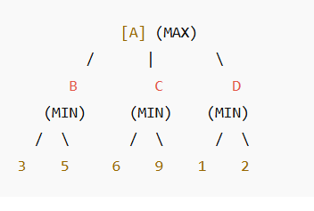
Alpha–Beta Pruning
It eliminates branches in the game tree that cannot possibly influence the final decision.
Two parameters are used:
- α (alpha): the best (maximum) value that the MAX player currently can guarantee.
- β (beta): the best (minimum) value that the MIN player currently can guarantee.
Pruning Rule:
If at any point α ≥ β, we stop exploring that branch (no need to evaluate further).
Step 1: Start from Root
At root A (MAX): α = −∞, β = +∞
Step 2: Explore Left Child (B)
B is a MIN node: α = −∞, β = +∞
Evaluate its children (3, 5):
First child: 3 → β = min(+∞, 3) = 3
Second child: 5 → β = min(3, 5) = 3
Return value to parent (A): 3
Now, α at A = max(−∞, 3) = 3

Slide 19
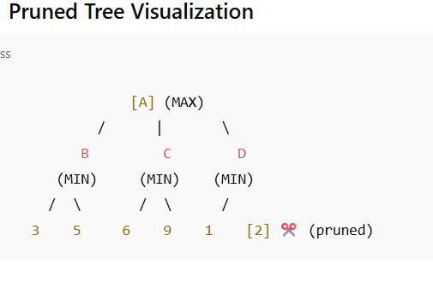
Step 3: Explore Middle Child (C)
C is MIN node: α = 3 (from A), β = +∞
Evaluate its children (6, 9):
First child: 6 → β = min(+∞, 6) = 6
Now, check pruning condition:
Since α (3) < β (6), continue.
Second child: 9 → β = min(6, 9) = 6
Return value to A: 6
Now α = max(3, 6) = 6
Step 4: Explore Right Child (D)
D is MIN node: α = 6, β = +∞
Evaluate its children (1, 2):
First child: 1 → β = min(+∞, 1) = 1
Now α ≥ β → (6 ≥ 1) ✅
→ Prune the remaining child (2), no need to check.
Return value to A: 1
Step 5: Final Decision at A
MAX chooses among {3, 6, 1} →
✅ Best Move = 6 (from C)
✅ Final Result:
Best Value: 6
Best Move: Path A → C → 6
Pruning Saved: One branch (value 2) was skipped.

Slide 20
Enhancing Minimax with Alpha-Beta Pruning
Alpha-Beta Pruning optimizes Minimax by skipping unnecessary branches of the decision tree. It maintains two values:
Alpha: The best score the Maximizer can guarantee so far.
Beta: The best score the Minimizer can guarantee so far.
If a branch cannot improve the current alpha or beta values,
it is pruned, reducing computation time. This optimization makes Minimax feasible for complex games with deeper trees.

Slide 21
Alpha-Beta Pruning
Alpha Beta Pruning optimizes AI decision-making by reducing unnecessary computations in the minimax algorithm. Learn its workings, benefits, and real-world applications in gaming and beyond.
Alpha Beta Pruning is a search optimization technique that improves the performance of the minimax algorithm. The minimax algorithm is a decision-making process commonly used in two-player, zero-sum games like chess. In such games, one player aims to maximize their score while the other seeks to minimize it.
The minimax algorithm operates by recursively exploring all possible game states (represented as a tree structure) and assigning values to the leaf nodes based on the potential outcomes of the game.
The key idea behind Alpha Beta Pruning is to avoid evaluating branches of the game tree that cannot influence the final decision based on the values already discovered during the search. It achieves this using two values: Alpha and Beta.

Slide 22
Alpha-Beta Pruning
Alpha-Beta pruning is an optimization technique for the Min-Max algorithm. It eliminates branches in the search tree that don’t affect the final decision, improving efficiency.
Alpha (α): The best (highest) value that the Max player can guarantee at that point or above.
Beta (β): The best (lowest) value that the Min player can guarantee at that point or above.
How it works:
While exploring nodes, if the current node’s value is worse than the previously explored options, the algorithm prunes (cuts off) that branch.
This avoids unnecessary calculations and reduces time complexity.
Example:
Using the previous example, if during exploration we find a node value that is worse than a previously known value, we stop exploring further descendants.

Slide 23
How Alpha Beta Pruning Works
Alpha and Beta Values
Alpha represents the best (highest-value) value that the maximizing player (usually the AI) can guarantee so far. It acts as a lower bound. The initial value of alpha is −∞.
Beta represents the best (lowest-value) value that the minimizing player (the opponent) can guarantee so far. It acts as an upper bound. The initial value of alpha is +∞.
The Pruning Process
As the AI explores the tree, it keeps track of Alpha and Beta values. When exploring a node, it compares the node’s value against these values.
If, at any point, Alpha becomes greater than or equal to Beta; it means the current branch will not affect the final decision because the opponent will avoid this path in favor of a better one. As a result, this branch is pruned, and the algorithm moves on to the next branch.
This process allows the algorithm to skip large parts of the tree, significantly reducing the number of nodes to be evaluated.

Slide 24
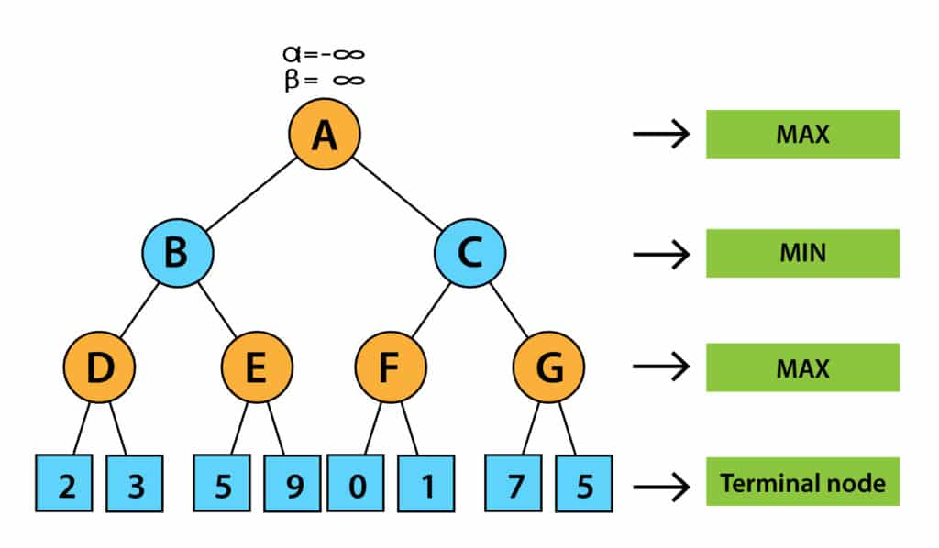
Working of Alpha-beta Pruning
1. First, we will take care of the first move. So initially, we will define the worst case α = −∞ and β = +∞. If alpha is greater than or equal to beta, we will prune the node.

Slide 25
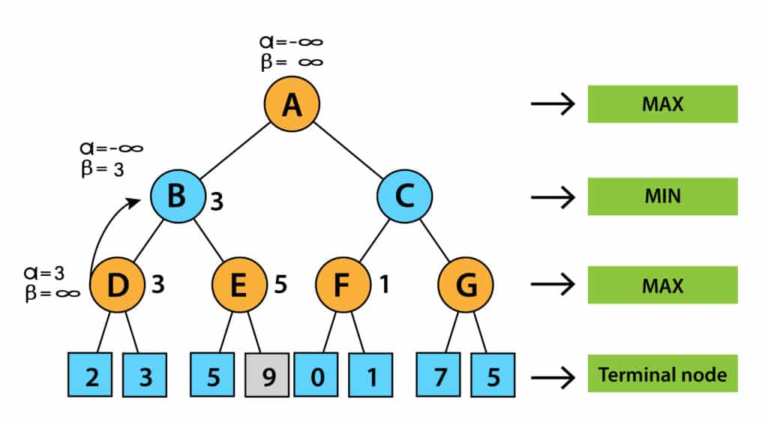
2. We didn’t prune it since the initial value of alpha is less than beta. Now it’s turn for MAX. Therefore, we will calculate the value of alpha at node D. At node D, the value of alpha will be max (2, 3) = 3.
3. Now, node B’s turn is MIN. That means that the value of alpha beta at node B will be min (3, ∞). Therefore, alpha will be – ∞ and beta will be 3 at node B.
Next, algorithms will pass the values of α= -∞ and β= 3 to the next successor of Node B, that is node E.

Slide 26
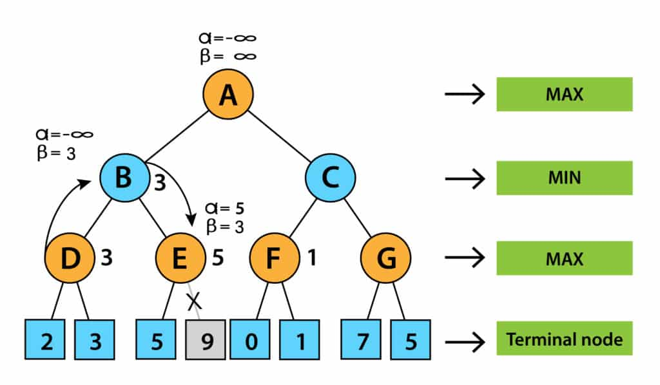
4. Now it’s turn for MAX. Therefore, we will search for MAX at node E. The value of alpha at E is – ∞ and will be compared with 5. So, MAX (- ∞, 5) will be 5. Thus, at node E, alpha = 5, Beta = 5.
We now know that alpha is greater than beta and is also a pruning condition, so we can prune the right successor of node E, and the algorithm will not be visited, and the value of node E will be 5.

Slide 27
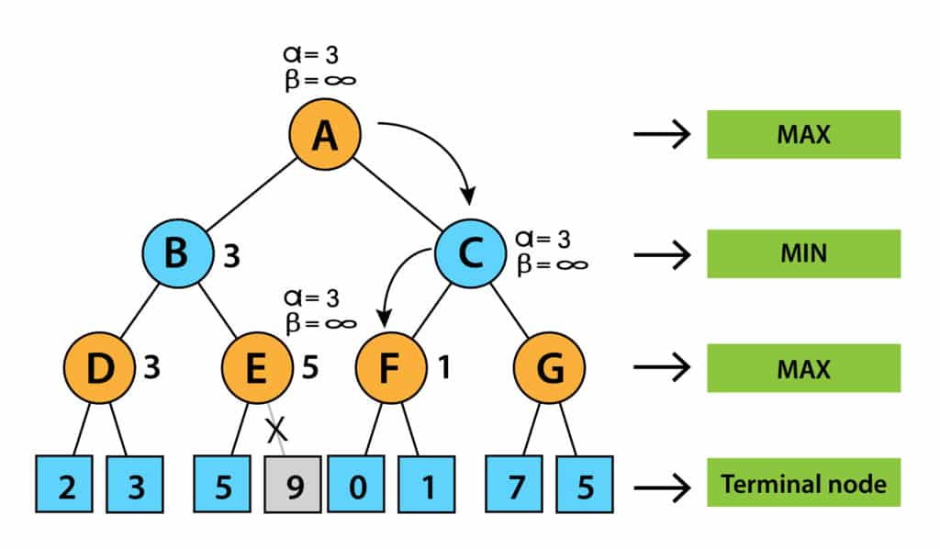
5. In the next step, the algorithm again comes from node B to node A. The alpha of node A is changed to the max value of MAX(- ∞, 3). Now, alpha and beta at node A are (3, + ∞) and will be transmitted to node C. The same values will be transferred to node F.
6. The value of alpha will be compared to the left branch, which is 0 at node F. Now, MAX (0, 3) will be 3 and is compared with the right child (1) and MAX(3, 1) = 3 still α is 3, but the node value of F will be 1.

Slide 28
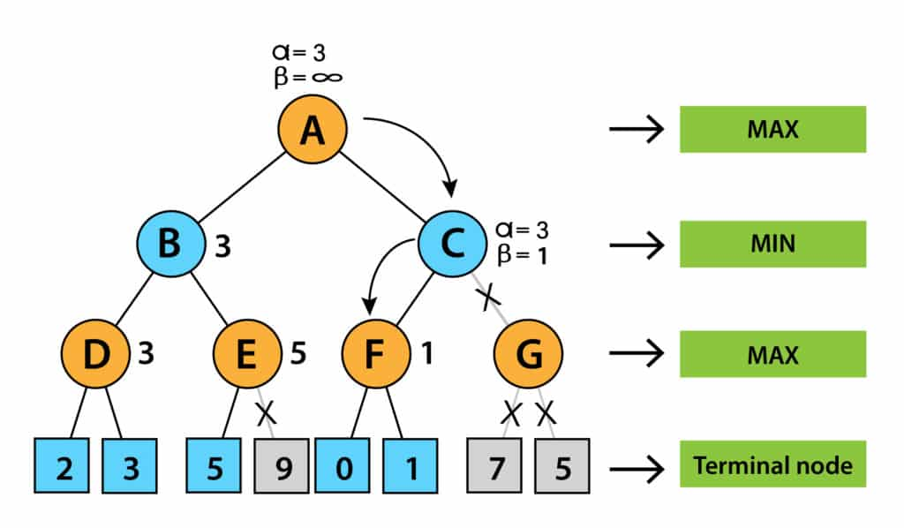
7. Afterward, node F will pass the node value 1 to C and compare it to the beta value at C. Now it’s turn for MIN. So, MIN (+ ∞, 1) will be 1. Now, at node C, α = 3, β= 1, and alpha is greater than beta, which again satisfies the pruning condition. Then, the successor of node C, G, will be pruned, and the algorithm did not calculate the whole subtree G.

Slide 29
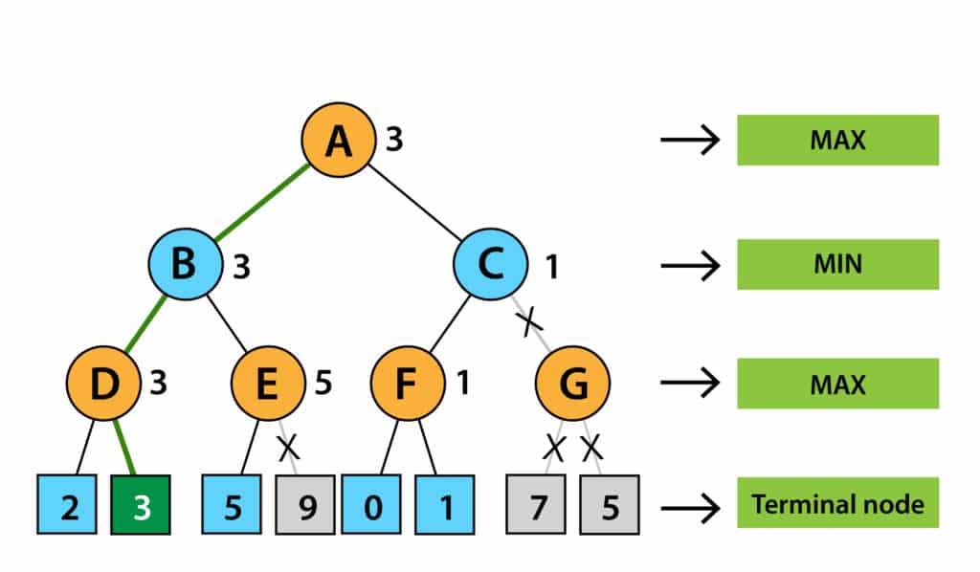
Now, C will return its node value to A, and A will calculate MAX(1, 3), resulting in 3.
This above-represented tree is the final tree that has nodes that are computed and nodes that are not computed. Therefore, in this example, the optimal value of the maximizer would be 3.

Slide 30
Key Benefits of Alpha Beta Pruning in AI
1. Improved Efficiency- Alpha Beta Pruning significantly reduces the amount of computation required. The algorithm can focus on evaluating only the most relevant parts of the tree, making decision-making much faster.
2. Reduced Time Complexity- Without pruning, the minimax algorithm has a time complexity of O(b^d), where b represents the branching factor (the number of possible moves) and d is the depth of the tree. With Alpha Beta Pruning, the time complexity can be reduced to O(b^(d/2)) in the best case, enabling the AI to explore deeper levels of the tree much more efficiently.
3. Scalability-As AI applications become more complex and require deeper search trees (e.g., in chess or Go), Alpha Beta Pruning makes exploring these larger search spaces feasible. The ability to prune unnecessary branches means that AI systems can handle more complex decision-making tasks in real time.

Slide 31
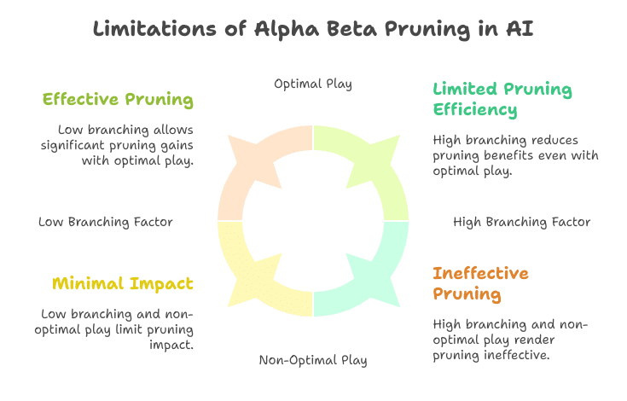

Slide 32
Alpha Beta Pruning is an essential optimization technique for AI decision-making algorithms. By significantly reducing the number of nodes that need to be evaluated, it makes complex decision-making processes more efficient and feasible, even for large-scale problems.
Whether in game-playing AI, robotics, or optimization systems, Alpha Beta Pruning is a cornerstone of AI algorithms that require fast and accurate decision-making.

Slide 33
Game Tree and State representation:
Game Tree:
Tree structure showing:
  All possible moves
  Opponent responses
  Outcomes
Components:
Root Node → Current state
Leaf Node → Terminal state
Branch → Possible moves
Depth → Number of moves ahead
State Representation:
Board configuration
Player turn
Score or utility values

Slide 34
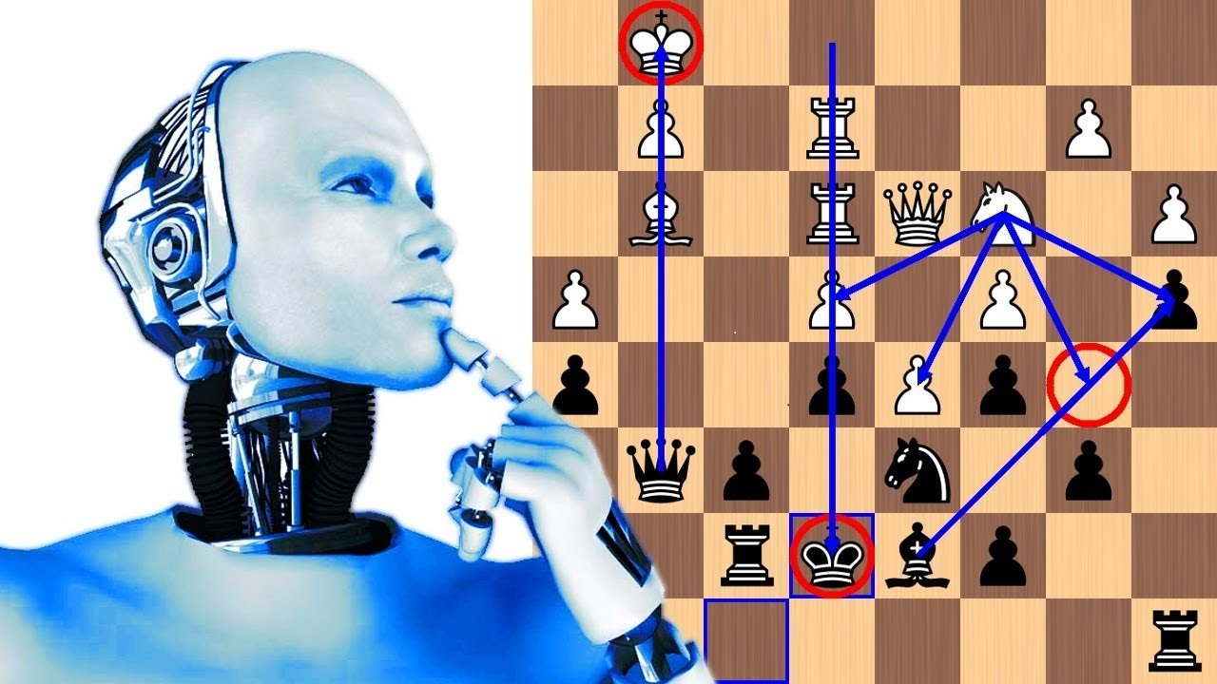
Real World applications in AI
Uses:
Chess engines (Stockfish, AlphaZero)
Strategy games
Robotics planning
Military simulation
Stock market modeling
Cyber-security attack-defense modeling

Slide 35
Summary of the Lecture
Game playing is adversarial
Mini-Max evaluates max-min strategy
Alpha-Beta improves runtime
Game trees represent choices
Move ordering improves performance
Game AI applied to many domains

Slide 36
Quiz/ FAQ’s
Define game playing in the context of Artificial Intelligence.
Explain the purpose of the Min-Max algorithm in AI.
Differentiate between Min and Max nodes in Min-Max search.
State the types of games where the Min-Max algorithm is applicable.
Describe the concept of Alpha-Beta Pruning in AI.
Explain the way Alpha-Beta Pruning enhances the efficiency of game tree search.
State the best-case and worst-case time complexity of Min-Max with Alpha-Beta Pruning.
Describe the Monkey and Banana problem as used in AI planning.
Explain the method of representing the Monkey and Banana problem in AI.
Identify the goal state in the Monkey and Banana problem.

Slide 37
Faculty-curated videos, NPTEL, Coursera, LinkedIn, or other relevant learning resources
43
https://ocw.mit.edu/
https://cs.stanford.edu/
https://coursera.org
https://inst.eecs.berkeley.edu/~cs188/
https://cs221.stanford.edu/

Slide 38

11
Class-Wise Feedback

Slide 39
Thank You
For queries
Email: Prabhjot.e16646@cumail.in

